Slide 1
Using The Past To Score The Present: Extending Term Weighting Models with Revision History Analysis
CIKM’10
Advisor：Jia Ling, Koh
Speaker：SHENG HONG, CHUNG

Slide 2
Outline
Introduction
Revision History Analysis
Global Revision History Analysis
Edit History Burst Detection
Revision History Burst Analysis
Incorporating RHA in retrieval models
System implementation
Experiment
Conclusion

Slide 3
Introduction
Many researches will use modern IR models
Term weighting becomes central part of these models
Frequency-based
These models only examine one(final) version of the document to be retrieved, ignoring the actual document generation process.

Slide 4
IR model
document
document
after many revision
original
latest
Term frequency
True term frequency

Slide 5
Introduction
New term weighting model
Use the revision history of the document
Redefine term frequency
In order to obtain a better characterization of term’s true importance in a document

Slide 6
Revision History Analysis
Global revision history analysis
Simplest RHA model
document grows steadily over time
a term is relatively important if it appears in the early revisions.

Slide 7
Revision History Analysis
Frequency of term $t$ in revision $v_{j}$
$${TF}_{global}\left(t,d\right)=\sum_{j=1}^{n}{\frac{c(t,v_{j})}{j^{α}}}$$
Decay factor
d：document d form a versioned corpus D
V = { v₁,v₂,….,v_{n} }：revision history of d
c(t,d)：frequency of term t in d
$j^{α}$ ：decay factor

Slide 8
Revision History Analysis
d : { a,b,c } tf(a=3 b=2 c=1)
V = {v₁,v₂,v₃}
v₁ = {a,b,c} tf(a=4 b=3 c=3)
v₂ = {a,b,c} tf(a=5 b=2 c=1)
v₃ = {a,b,c,e} tf(a=5 b=3 c=2 e=2)
TF_{global}(a,d) = 4/1$α$+5/2$α$+5/3$α$
= 4/1+5/2.14355+5/3.34837
= 4+2.333+1.493 = 7.826
TF_{global}(e,d) = 0/1$α$+0/2$α$+2/3$α$
= 0.597

Slide 9
Burst
1st revision:
500th revision:
Current revision:

Slide 10
Burst
Burst of Document (Length) & Change of Term Frequency
Time | Term Frequency |  | Document Length
 | “Pandora” | “James Cameron”
Nov. 2009 | 9 | 23 | 2576
Dec. 2009 | 25 | 50 | 6306
Burst of Edit Activity & Associated Events
Month (2009) | Jul. | Aug. | Sep. | Oct | Nov. | Dec.
Edit Activity | 89 | 224 | 67 | 154 | 232 | 1892
First photo & trailer released
Movie released
Global Model might be insufficient

Slide 11
Edit History Burst Detection
Content-based
Relative content change $\underset{⇒}{Δc}$ potential burst
$$ℬ_{c}\left(v_{j}\right)=\left\{\begin{aligned}1, \frac{|v_{j}|−|v_{j−1}|}{|v_{j−1}|}>α \\ 0, otherwise \end{aligned}\right.$$
$|v_{j}|$ : content length for j-th revision

Slide 12
Edit History Burst Detection
Activity-based
Intensive edit activity $\underset{⇒}{Δt }$ potential bursts
$${ ℬ}_{a}\left({ep}_{j}\right)=\left\{\begin{aligned}1, revision counts in Δt>μ+σ \\ 0, otherwise \end{aligned}\right.$$
Average revision counts
Deviation
$${ℬurst}_{}\left(v_{j}\right)=\left\{\begin{aligned}1, if Burstc\left(vj\right)+Bursta\left(vj\right)>0 \\ 0, otherwise \end{aligned}\right.$$

Slide 13
Revision History Burst Analysis
A burst resets the decay clock for a term.
The weight will decrease after a burst.
Frequency of term $t$ in revision $v_{k}$
$${TF}_{burst}\left(t,d\right)=\sum_{j=1}^{m}{\sum_{k=b_{j}}^{n}{\frac{c(t,v_{k})}{{(k−b_{j}+1)}^{β}}}}$$
Decay factor for j^{th} Burst
B = {b₁,b₂,….b_{m}} : the set of burst indicators for document d
b_{j} : the value of b_{j} is the revision index of the end of the j-th burst of document d

Slide 14
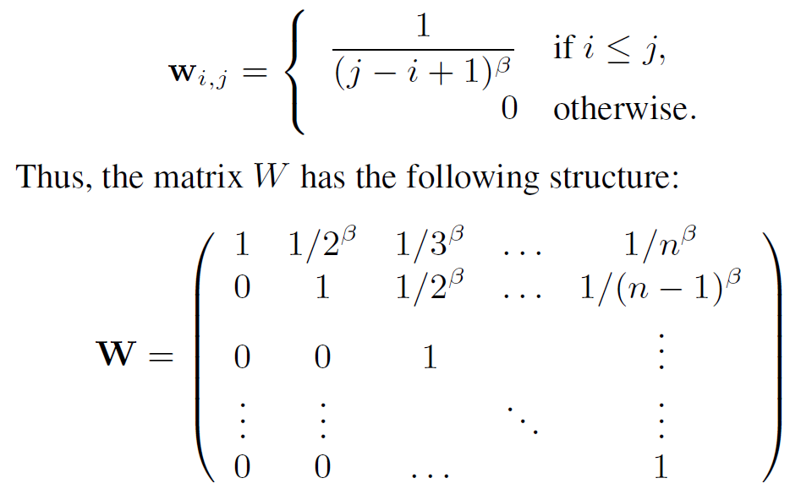
Revision History Burst Analysis
W : decay matrix
i : a potential burst position
j : a document revision

Slide 15
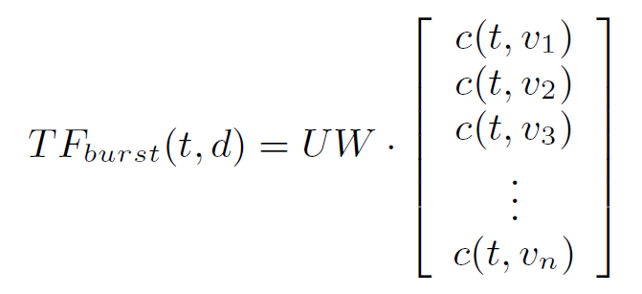
Revision History Burst Analysis
U = [u₁,u₂…u_{n}] : the burst indicator that will be used to
filter the decay matrix W to contain only
the true bursts

Slide 16
Revision History Burst Analysis
d : { a,b,c } tf(a=3 b=2 c=1)
V = {v₁,v₂,v₃,v₄}
B = {b₁,b₂,b₃,b₄} = {1,0,1,0}
V₁ = {a,b,c,d} tf(a=50 b=20 c=30 d=10)
V₂ = {a,b,c,d} tf(a=52 b=21 c=33 d=10)
V₃ = {a,b,c,d} tf(a=70 b=35 c=40 d=20)
V₄ = {a,b,c,d} tf(a=73 b=33 c=48 d=21)

Slide 17
Incorporating RHA in retrieval models
BM25
+ RHA
$$S\left(Q,D\right)=\sum_{tεQ}{IDF\left(t\right)∙\frac{TF\left(t,D\right)∙\left(k_{1}+1\right)}{TF\left(t,D\right)+k_{1}\left(1−b+b∙\frac{\left|D\right|}{avgdl}\right)}}$$
$${TF}_{rha}\left(t,D\right)$$
$${TF}_{rha}\left(t,D\right)$$
Statistical Language Models
+ RHA
$$S\left(Q,D\right)=D(Q|\left|D\right)=\sum_{tεV}{P\left(t|Q\right)∙\log{\frac{P\left(t | Q\right)}{P\left(t | D\right)}}}$$
$$P_{rha}\left(t,D\right)$$
RHA Term Frequency:
$${TF}_{rha}\left(t,D\right)=λ_{1}{∙TF}_{g}\left(t,D\right)+λ_{2}{∙TF}_{b}\left(t,D\right)+λ_{3}∙TF\left(t,D\right)$$
RHA Term Probability:
$$P_{rha}\left(t,D\right)=λ_{1}{∙P}_{g}\left(t,D\right)+λ_{2}{∙P}_{b}\left(t,D\right)+λ_{3}∙P\left(t,D\right)$$
$$λ_{1}+λ_{2}+ λ_{3}=1$$
$λ_{1},λ_{2} and λ_{3} i$ndicate the weights of RHA global model, burst model and original term frequency (probability).

Slide 18
System implementation
The date of creating/editing.
Content change
Revision History Analysis

Slide 19
Evaluate metrics
Queries and Labels:
INEX: provided
TREC: subset of ad-hoc track
Metrics:
Bpref (robust to missing judgments)
MAP: mean average precision
R-prec: precision at position R
NDCG: normalized discounted cumulative gain

Slide 20
Dataset
INEX: well established forum for structured retrieval tasks (based on Wikipedia collection)
TREC: performance comparison on different set of queries and general applicability
INEX 64 topic
Wiki
Dump
Top 1000 retrieved articles
1000 revisions for each article
Corpus for INEX
TREC 68 topic
Top 1000 retrieved articles
1000 revisions for each article
Corpus for TREC

Slide 21
INEX Results
Model | bpref | MAP | R-precision
BM25 | 0.354 | 0.354 | 0.314
BM25+RHA | 0.375 (+5.93%) | 0.360 (+1.69%) | 0.337 (+7.32%)
LM | 0.357 | 0.370 | 0.348
LM+RHA | 0.372 (+4.20%) | 0.378 (+2.16%) | 0.359 (+3.16%)
Parameters tuned on INEX query Set
BM25: $λ_{1}=0.3 ,λ_{2}=0.4$, $λ_{3}=0.3$
LM: $λ_{1}=0.3 ,λ_{2}=0.2$, $λ_{3}=0.5$

Slide 22
TREC Results
Model | bpref | MAP | NDCG
BM25 | 0.524 | 0.548 | 0.634
BM25+RHA | 0.547** (+4.39%) | 0.568 ** (+3.65%) | 0.656** (+3.47%)
LM | 0.527 | 0.556 | 0.645
LM+RHA | 0.532 (+0.95%) | 0.567 (+1.98%) | 0.653 (+1.24%)
parameters tuned on INEX query Set, ** indicates statistically significant differences @ the 0.01 significance level with two tailed paired t-test
BM25: $λ_{1}=0.3 ,λ_{2}=0.4$, $λ_{3}=0.3$
LM: $λ_{1}=0.3 ,λ_{2}=0.2$, $λ_{3}=0.5$

Slide 23
Cross validation on INEX
Model | bpref | MAP | R-precision
BM25 | 0.307 | 0.281 | 0.324
BM25+RHA | 0.312 (+1.63%) | 0.291 (+3.56%) | 0.320 (-1.23%)
LM | 0.311 | 0.284 | 0.348
LM+RHA | 0.338 (+8.68%) | 0.298 (+4.93%) | 0.359 (+0.61%)
5-fold cross validation on INEX 2008 query Set
Model | bpref | MAP | R-precision
BM25 | 0.354 | 0.354 | 0.314
BM25+RHA | 0.363 (+2.54%) | 0.348 (-1.70%) | 0.333 (+6.05%)
LM | 0.357 | 0.370 | 0.348
LM+RHA | 0.366 (+2.52%) | 0.375 (+1.35%) | 0.352 (+1.15%)
5-fold cross validation on INEX 2009 query Set

Slide 24
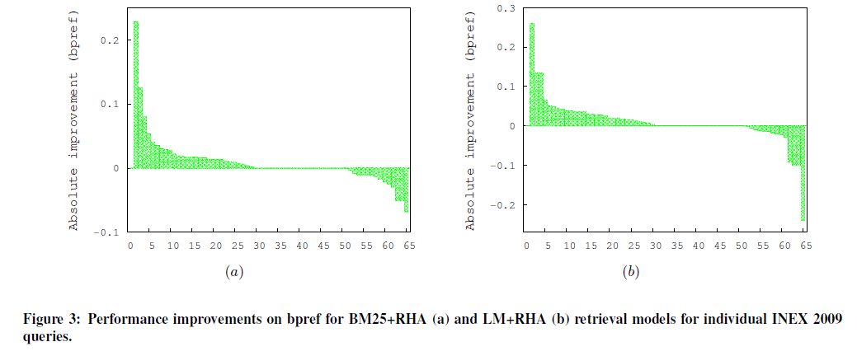
Performance Analysis

Slide 25
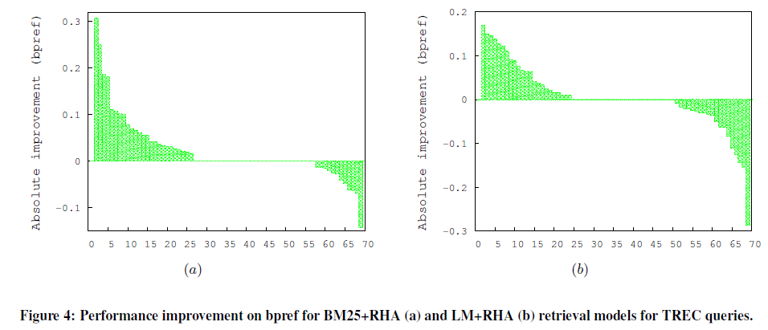
Performance Analysis

Slide 26
Conclusion
RHA captures importance signal from document authoring process.
Introduced RHA term weighting approach
Natural integration with state-of-the-art retrieval models.
Consistent improvement over baseline retrieval models

